Slide 1
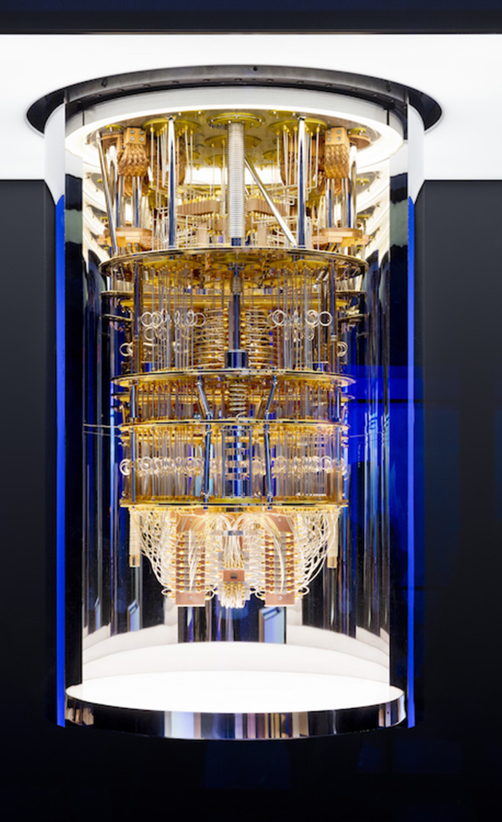
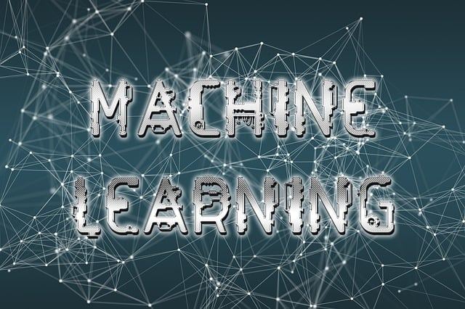
QC Programming and Applications
In Machine Learning
1
https://qiskit.org/documentation/qc_intro.html
Notes:
- Modificar Footer NO en MASTER, sino en insert header&footer por ejemplo “© J. Machín. Education material for 2024 UFV “Q&CC models” students

Slide 2
1. About this course:

Slide 3

Why this is a very useful course for you !
Yes, I know, QC is great and has a huge talent demand… Anything else?
You Will see Machine Learning algorithms : SVM, NN algorithms
You Will manage Python libraries
You Will manage different environments: Kaggle, Colab
You Will manage real use case
AI moves very fast: ChatGPT, Generative ML…
That is: you will be prepared to be flexible for your first job.

Slide 4
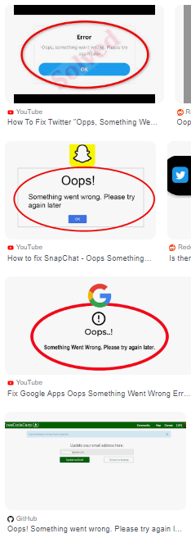


Machine Learning Platforms…
Kaggle
Colab
Real life: Multiple platforms and multiple “Ooops!”
Multiple: You have to solve your “Ooops!”
Learn to solve by yourself!

Slide 5
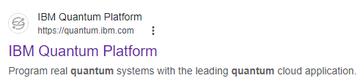
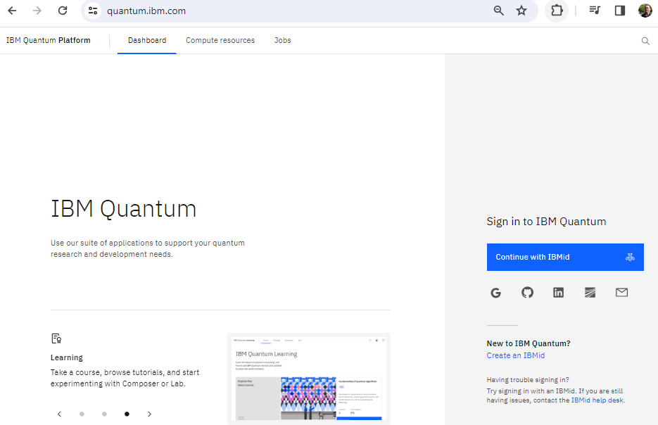
IBM Quantum Platform

Slide 6
Course “blocks”
SVM (classic ML)
QSVM
Neural networks (Classic ML)
Quantum Neural networks
Project management and design thinking in QC (Professor J.Machin)
Block 5 for PM and DS will be run on-line during the other first 4 blocks (J. Machín)

Slide 7
2. About us and logistics:

Slide 8
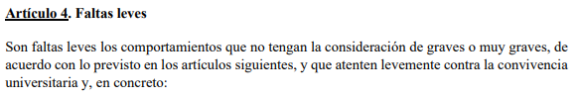
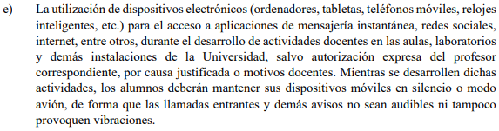

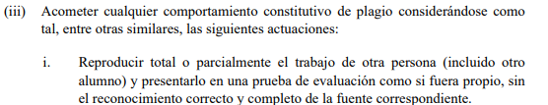

Normas de convivencia
ChatGPT / Geminis …
Balance Help and danger !

Slide 9

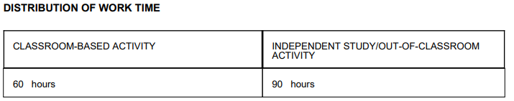
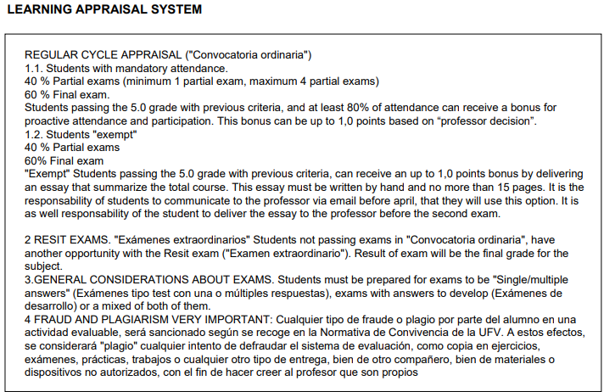
1 hour in classroom
1,5 hours student autonomour work
9

Slide 10
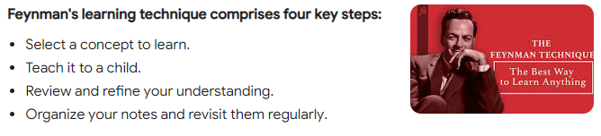
Doubts and Questions during the course. Several considerations. Pleeeeeeeeeeeease COMMON SENSE!
Your questions reflects your rationality ...
Based in a real case:
Professor: “Students pass with a grade greater than 4,9”
Student: “Professor, I got a 4,3 do I have to go to the resit exam? Professor, you don’t confirm to me!
2. Exams will be reviewed with class 15’ after finishing the exam. And you can tear the last page to write down your answers.
3. PFG: Student: “If I don’t pass in the ordinary cycle, I can not attend the PFG”. You can attend the PFG in resit cycle then.
4. Recommendation: Teamwork, study teams: Enrich your knowledge and your colleagues asking first to them:
1. It helps to filter very simple questions
2. Your doubts can be their doubts as well

Slide 11
Classes on tuesdays and Wednesday:
Tuesday:
Mandatory attendance on-site in UFV location. Attendance control
Wednesday:
Most of classes will be on-line. Attendance control
One monthly class can be on-site for exams, lessons review or whatever.

Slide 12
Thank Q

